Slide 1
ECE 884 Deep Learning
Lecture 10: Neural Networks
02/18/2021

Slide 2
Review of last lecture
Training
GD
SGD
Momentum, Adam, AdamW

Slide 3
Today’s lecture
(Deep) Neural Networks
Perceptron
Multilayer Perceptron (MLP)
Activation Functions
Why Neural Networks are powerful

Slide 4
Perceptron
The structural building block of deep learning

Slide 5
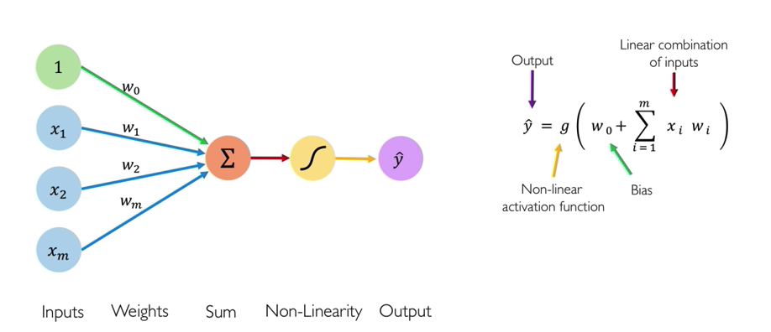
Perceptron

Slide 6
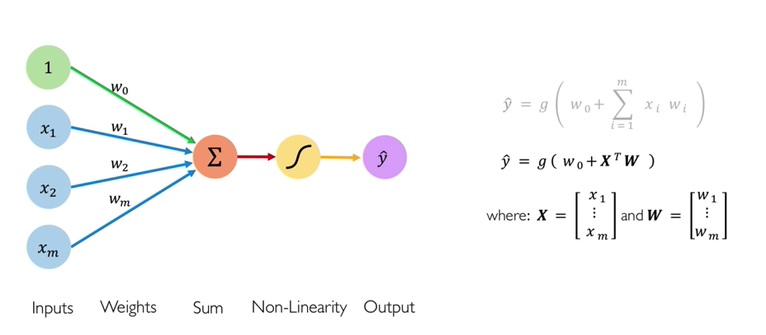
Perceptron

Slide 7
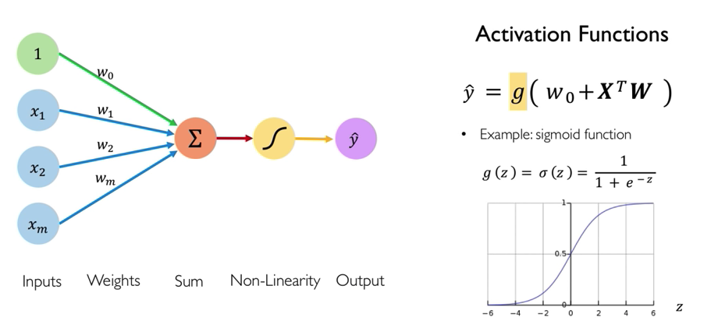
Perceptron

Slide 8
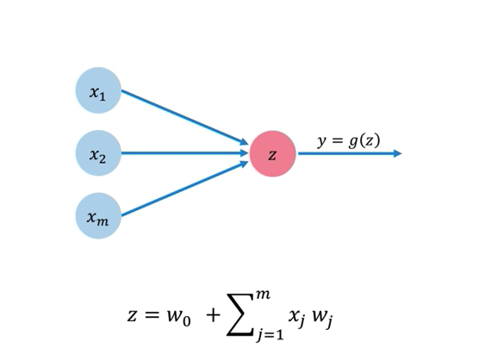
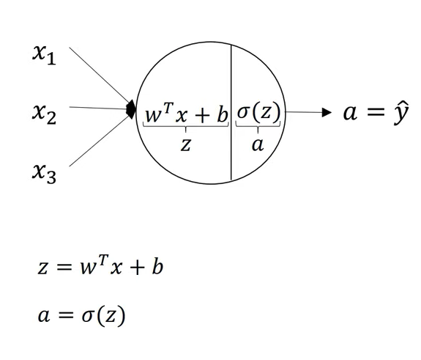
Building Neural Networks with Perceptron

Slide 9
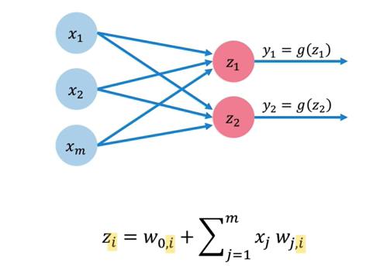
Building Neural Networks with Perceptron

Slide 10
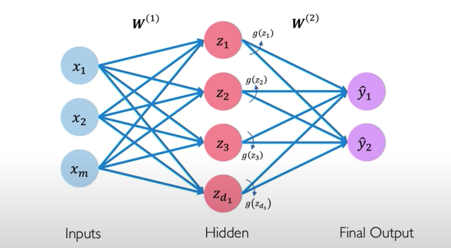
2-layer Neural Networks

Slide 11
2-layer Neural Networks
Before: Linear classifier
Now: 2-layer Neural Network
𝑓 𝑥
𝑓 𝑥
= 𝑊𝑥 + 𝑏
= 𝑊₂ g (𝑊 ₁ 𝑥 + 𝑏 ₁ ) + 𝑏 ₂
Input: 3072
x
W₁
h
W₂
s
Output: 10
Hidden layer: 100
Credit: Justin

Slide 12
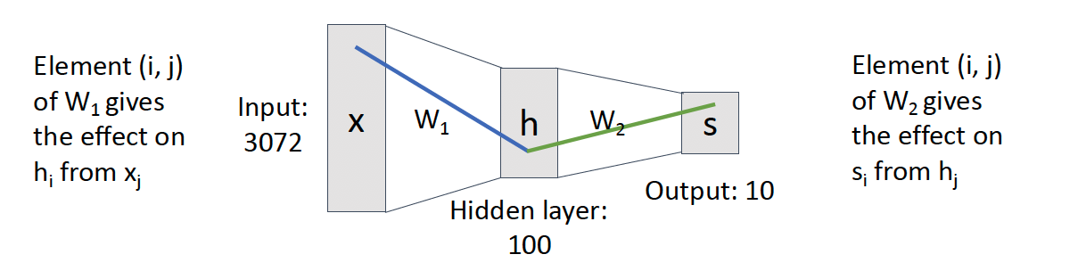
2-layer Neural Networks
Before: Linear classifier
Now: 2-layer Neural Network
𝑓 𝑥
𝑓 𝑥
= 𝑊𝑥 + 𝑏
= 𝑊₂ g (𝑊 ₁ 𝑥 + 𝑏 ₁ ) + 𝑏 ₂
Credit: Justin

Slide 13
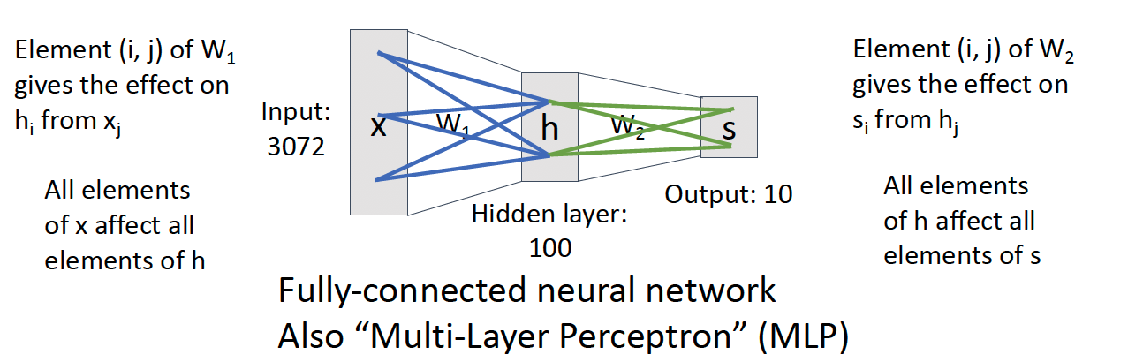
2-layer Neural Networks
Before: Linear classifier
Now: 2-layer Neural Network
𝑓 𝑥
𝑓 𝑥
= 𝑊𝑥 + 𝑏
= 𝑊₂ g (𝑊 ₁ 𝑥 + 𝑏 ₁ ) + 𝑏 ₂
Credit: Justin

Slide 14
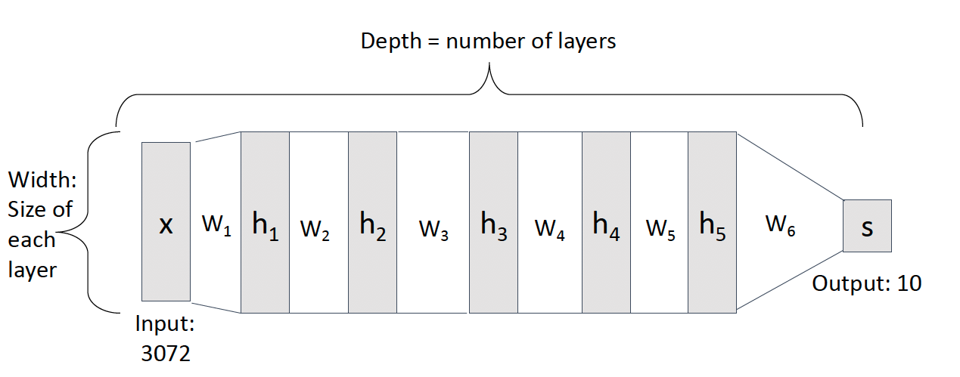
Deep Neural Networks
Credit: Justin

Slide 15
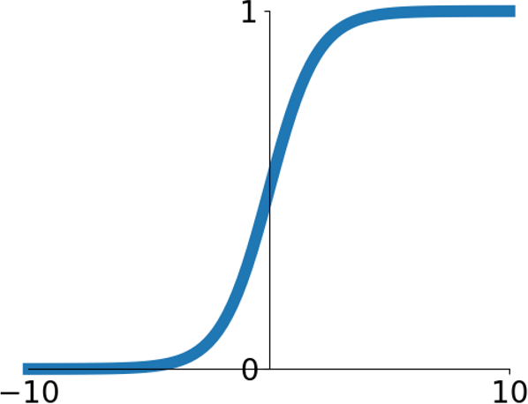
Activation Functions
Sigmoid
1
𝜎 𝑥 =
1 + 𝑒^{-x}
Probability interpretation

Slide 16
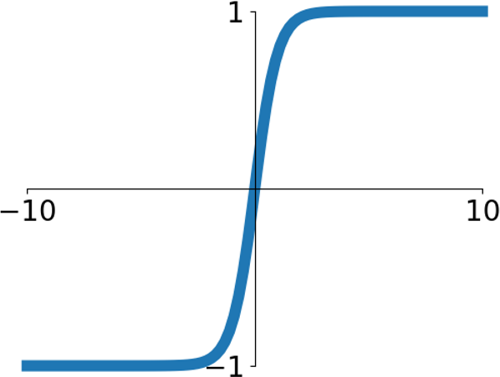
Activation Functions
tanh
tanh 𝑥
𝑒^{2x} − 1
⁼ 𝑒^{2x} + 1
Zero mean / Zero centered
tanh is always superior than sigmoid

Slide 17
Activation Functions
Sigmoid
tanh
tanh 𝑥
1
𝑒^{2x} − 1
𝜎 𝑥 =
1 + 𝑒^{-x}
⁼ 𝑒^{2x} + 1
Drawbacks:
gradient is small, and thus training (SGD) is slow
Exp () is computationally expensive

Slide 18
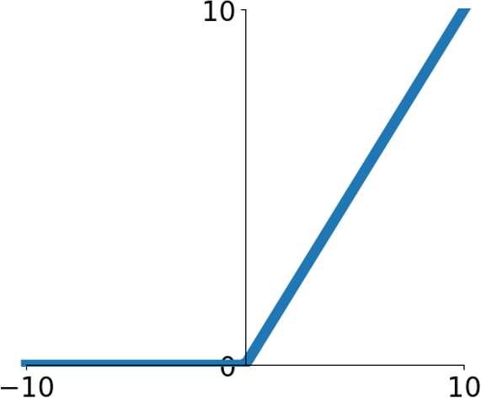
Activation Functions
ReLU (Rectified Linear Unit)
max(0, 𝑥)
Default choice of activation function, ReLU is a good default choice for most problems
Drawbacks:
Not zero centered.
Dead ReLU when x < 0

Slide 19
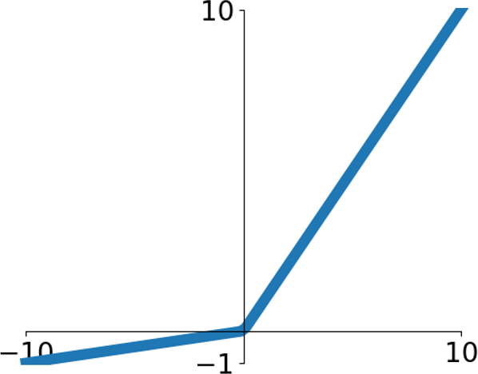
Activation Functions
Leaky ReLU
max 0.2𝑥, 𝑥
Less used

Slide 20
What happens if we build a neural network with no non-linear activation function?

Slide 21
N linear classifiers = 1 linear classifier

Slide 22










The power of non-linear activation function
Points not linearly separable in original space
x2
Consider a linear transform: h = Wx Where x, h are both 2-dimensional
x1
Credit: Justin

Slide 23


Consider a linear transform: h = Wx Where x, h are both 2-dimensional
Not linearly separable
Points not linearly separable in original space
x2
in feature space
h2
Feature transform: h = Wx
x1
h1
Credit: Justin

Slide 24
Consider a neural net hidden layer: h = ReLU(Wx) = max(0, Wx)
Where x, h are both 2-dimensional
Points not linearly separable in original space
x2
h2
Feature transform: h = ReLU(Wx)
x1
h1
Credit: Justin

Slide 25
Consider a neural net hidden layer: h = ReLU(Wx) = max(0, Wx)
Where x, h are both 2-dimensional
Points not linearly separable in original space
x2
h2
Feature transform: h = ReLU(Wx)
x1
h1
Points are linearly separable in features space!
Credit: Justin

Slide 26

x2
h2
x1
h1
Points are linearly separable in features space!
Linear classifier in feature space gives nonlinear classifier in original space
Credit: Justin

Slide 27
ReLU: Rectified Linear Units
ReLU, half-wave rectification, etc.

Slide 28
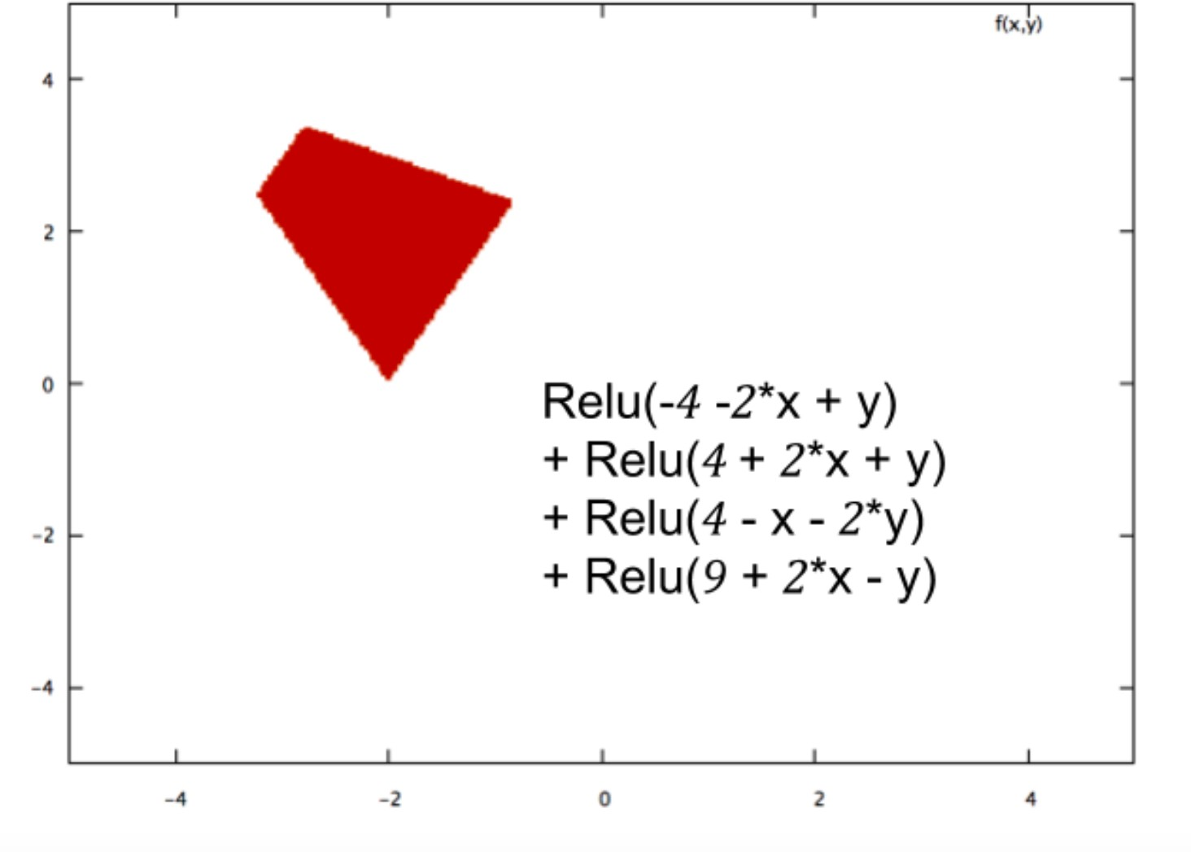
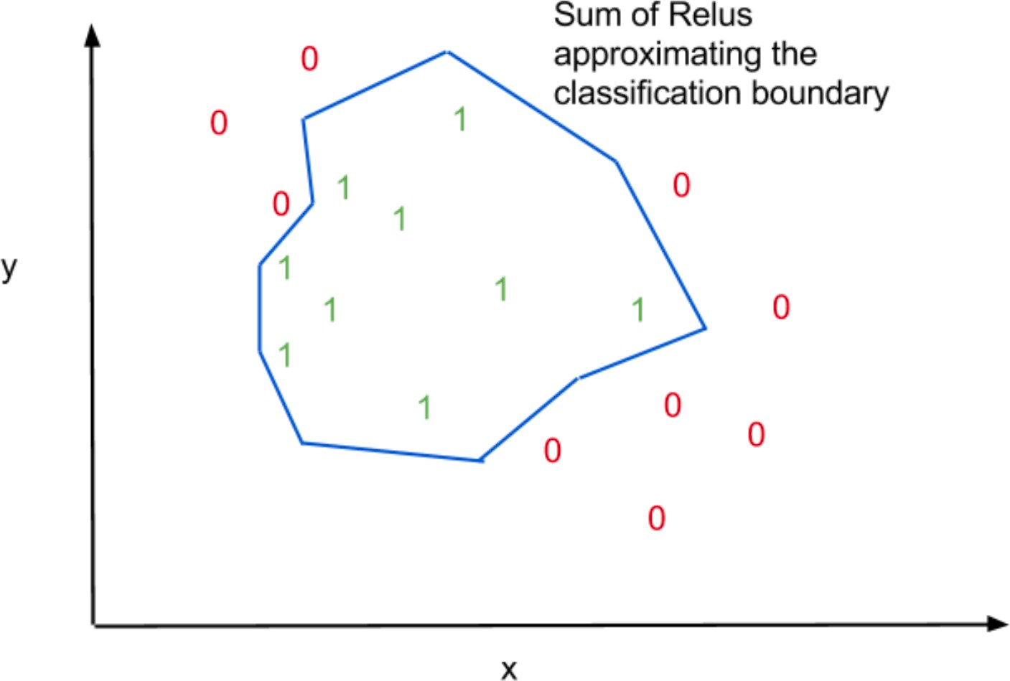
Credit: blog

Slide 29
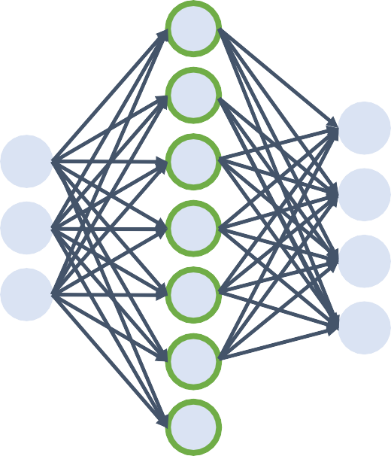
Universal Approximation
A simple FC-Non-Linearity network can approximate any function on a finite support, under:
mild assumptions
mild restrictions on non-linearity
First proven for Sigmoid by Cybenko 1989
Later extended for ReLU and other non-linearities
ŷ = w₂f(w₁x + b₁) + b₂
Credit: Krähenbühl.

Slide 30
Universal Approximation
A simple FC-Non-Linearity-FC network can approximate any function on a finite support, under:
mild assumptions
mild restrictions on non-linearity
Requires extremely large number of neurons in the FC layer
Hard to train
Computational infeasible
Theoretically possible
Credit: Krähenbühl.

Slide 31
Setting the number of layers and their sizes

Slide 32
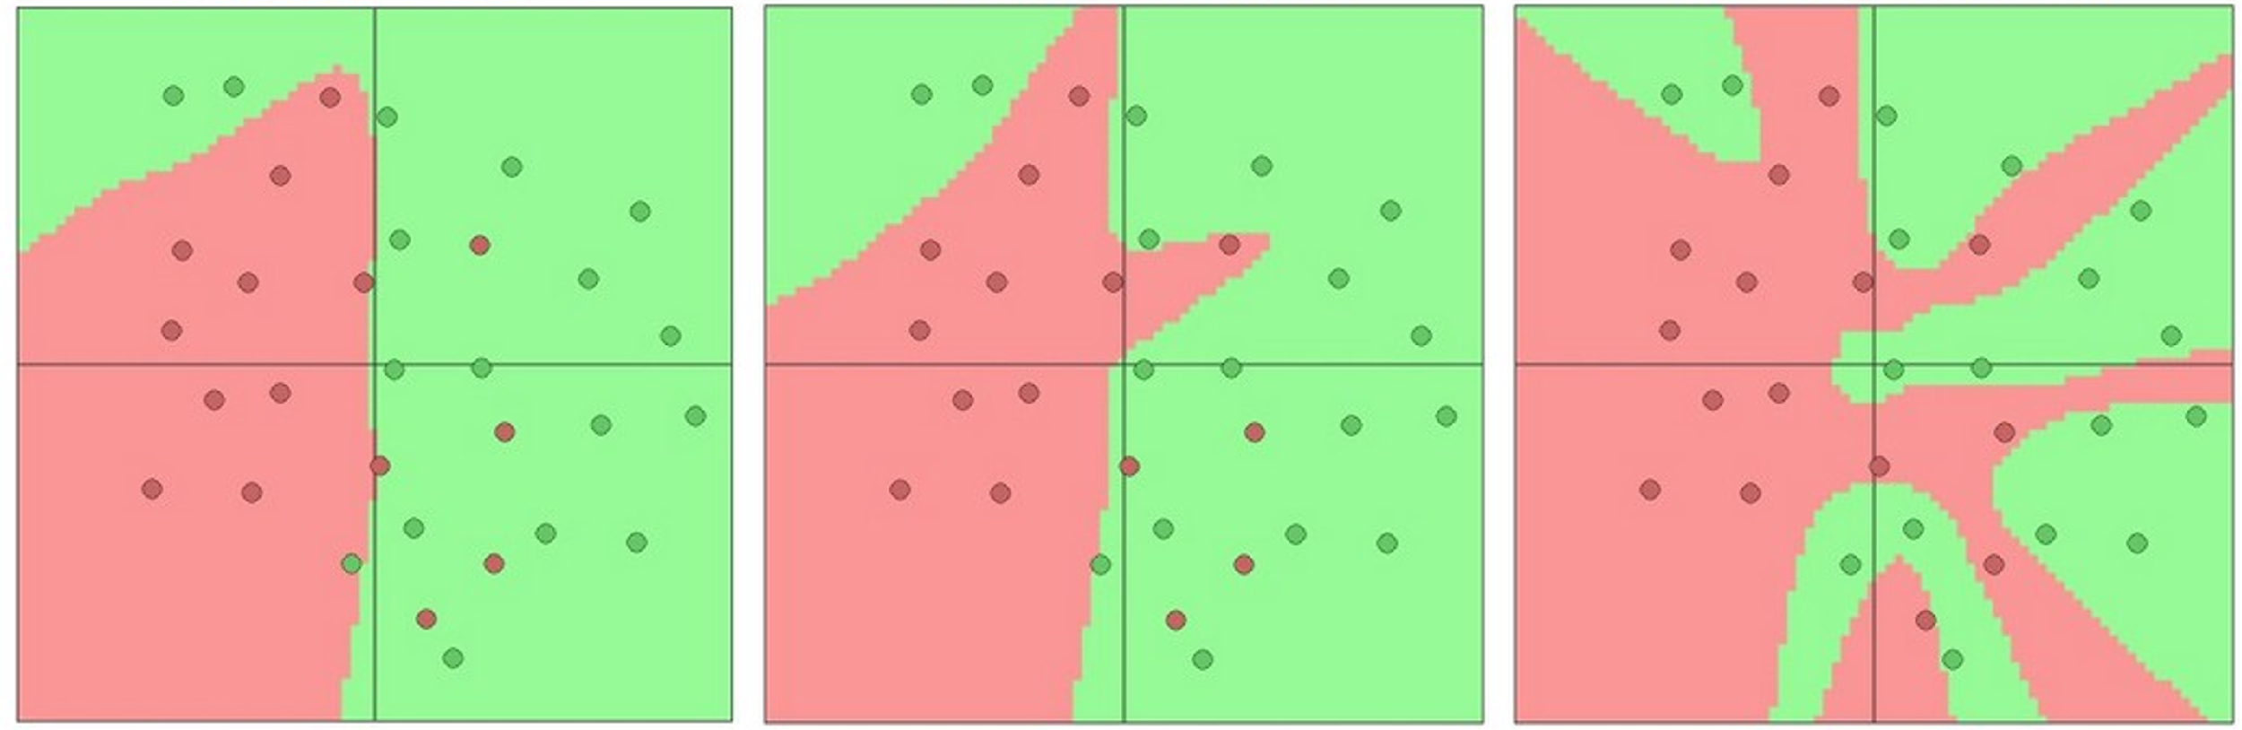
Setting the number of layers and their sizes
3 hidden units 6 hidden units 20 hidden units
More hidden units = more capacity
Credit: Justin

Slide 33
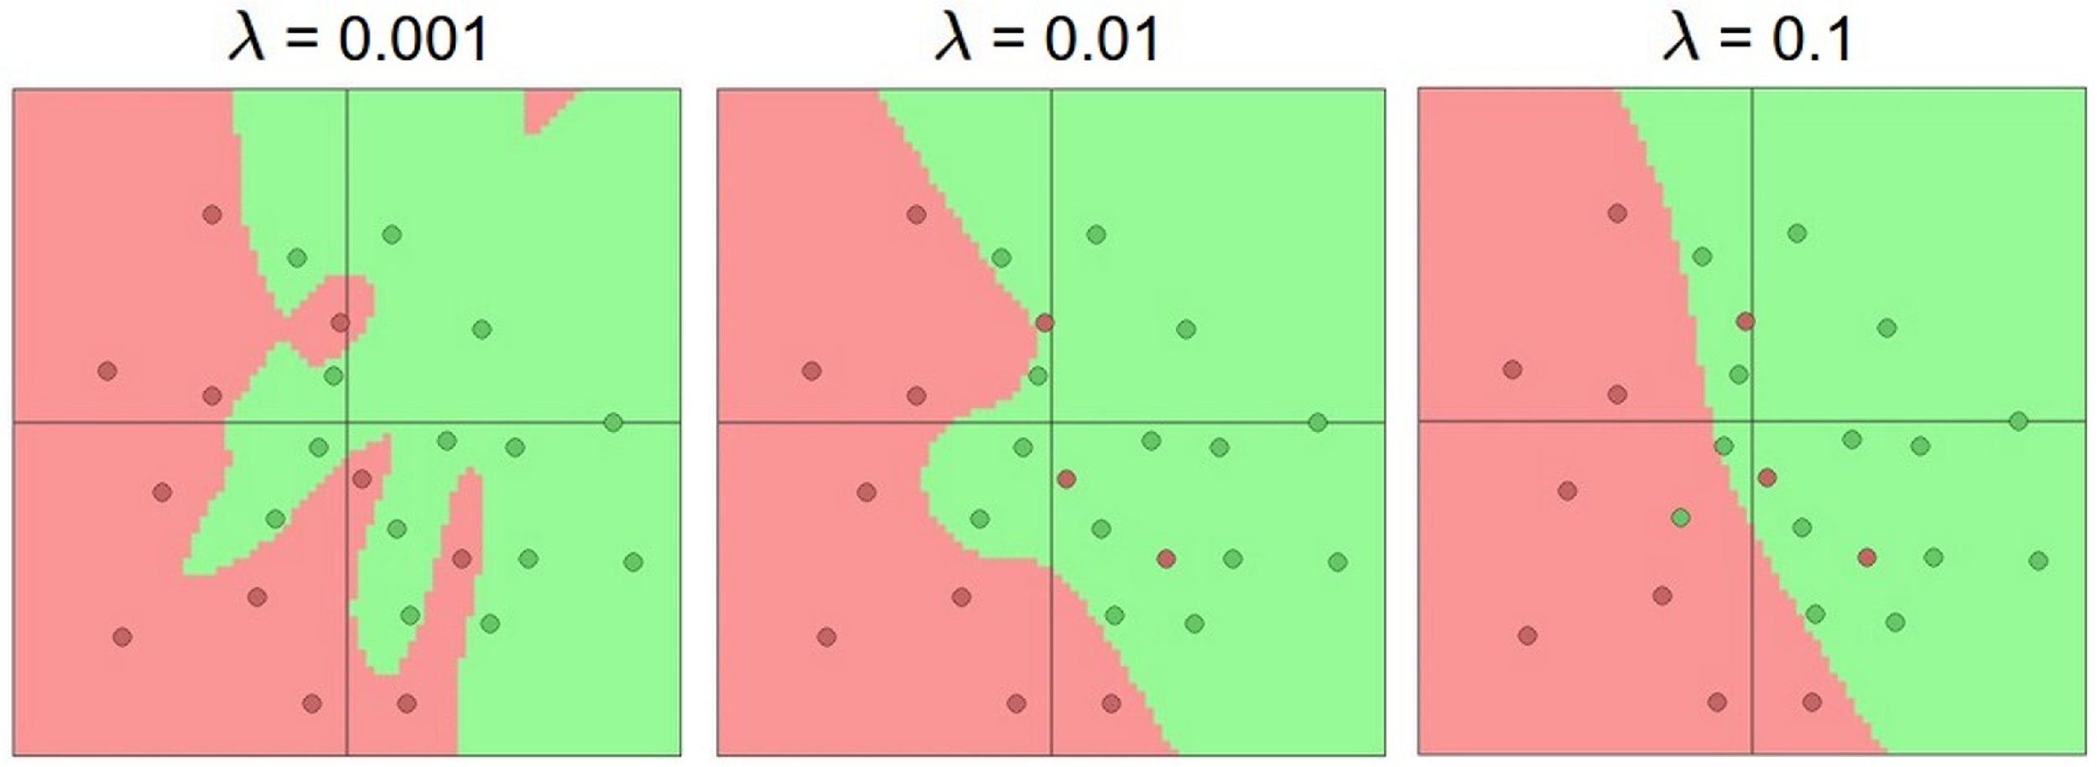
Don’t regularize with size; instead use stronger L2
Credit: Justin

Slide 34
Any Question ?

